Slide 1
Employee Data Analysis using Excel
STUDENT NAME: SANTHOSH S
REGISTER NO: 2213211042034 (unm13212213211042034)
DEPARTMENT: B.Com (CS)
COLLEGE: Presidency College

Slide 2
PROJECT TITLE
Employee Performance Analysis using Excel

Slide 3


AGENDA
Problem Statement
Project Overview
End Users
Our Solution and Proposition
Dataset Description
Modelling Approach
Results and Discussion
Conclusion
3/21/2024 Annual Review

Slide 4

PROBLEM STATEMENT
This project is done to get a analysis on a zone wise performance data to compare the type of employment. As it help the organisation to know how the employees are performing from a particular payzone on different scales.

Slide 5

PROJECT OVERVIEW
.
This projectgives us the data of performance on the basis of zones. For this we use excel and make a visualisation of the performance of different zones. Here we use pivot table for carrying out the same. Adding to it we use pivot analyze charts to visualize it in a bar format (Bar graph). These bars gives us the idea of comparing the performance of employee on basis of the type of their employment (part time, full time and temporary).

Slide 6

WHO ARE THE END USERS?
Organisation
Managers
Other empolyees

Slide 7

OUR SOLUTION AND ITS VALUE PROPOSITION
Filtering – to filter and to delete the blank values Pivot table – to aggregate values on basis of count Chart graph – to visualise the data in bar format

Slide 8
Dataset Description
This dataset comprises of 26 features out of which we took 4 features and the features are
Payzone – Categorical data representing 4 categories (Zone1,Zone2,Zone3,Zone4), this was given in filter column to check the performance status of different employments
Employeeclassificationtype – a categorical data which define the category whether they belong to full-time or part-time or temporary employees.
Performancescore – a categorical data which has following four categories namely: Exceeds, Fully Meets, Needs Improvement and PIP

Slide 9
MODELLING
Data collection – Kaggle website The data is collected from Kaggle website so it becomes the secondary data.
Data cleaning – filtering
The blank and missing data was removed after filtering the dataset from each column.
Data mining – Pivot table The data mining is done by the pivot table and extracted the useful information for our analysis.
Data Visualisation – chart graph
The data is visualised in bar format as we compare two categorical data on a particular heads.
9

Slide 10
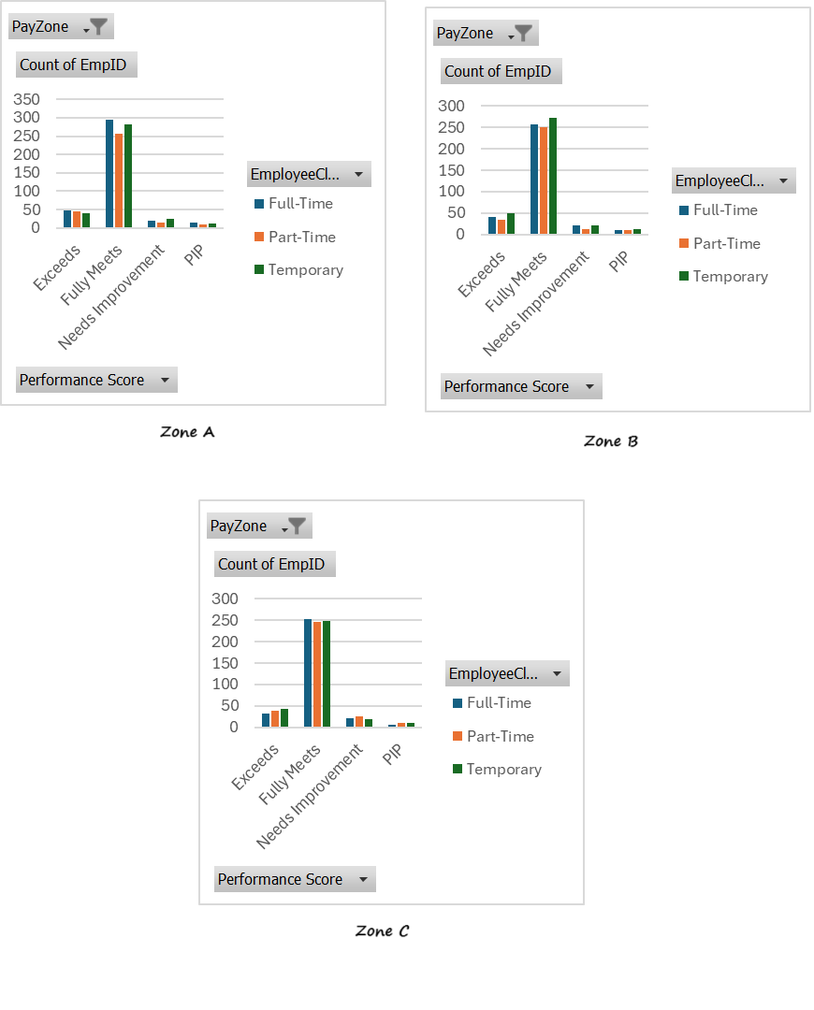
RESULTS
10

Slide 11
conclusion
In ZoneA “exceeds” category lead by full time employees whereas in other two zones lead by part-time employees. In Zone A “fully meet” category is lead by full-time employees whereas other two payzones lead by temporary employees.

